Slide 1
Protecting User Password Keys at Rest (on the Disk)

Slide 2
Problem Statement
Protecting User Password Keys at Rest (on the Disk)
In the digital age, securing sensitive data is paramount. Traditional password protection methods are vulnerable to breaches. A more robust solution is required to encrypt and decrypt files securely, with an additional feature to recover lost passphrases through brute-force methods

Slide 3
Unique Idea Brief (Solution)
1. Generate File Encryption Key (FEK)
Use a secure random key generator for the File Encryption Key (FEK).
2. Encrypt the File or Directory
Encrypt the chosen file or directory using the FEK with AES-256.
3. Protect the FEK with a User Passphrase
Use a Key Derivation Function (KDF) to derive a key from the user passphrase.
Encrypt the FEK using this derived key and store it securely.
4. Decrypt the File Using the FEK
Authenticate the user with the passphrase.
Derive the key using the KDF.
Decrypt the FEK and then use it to decrypt the file or directory.

Slide 4
Features Offered
Encryption of plain text of a file.
Decryption of cipher text of a file.
Brute-force Recovery of a forgotten Passphrase.
User friendly Interface

Slide 5
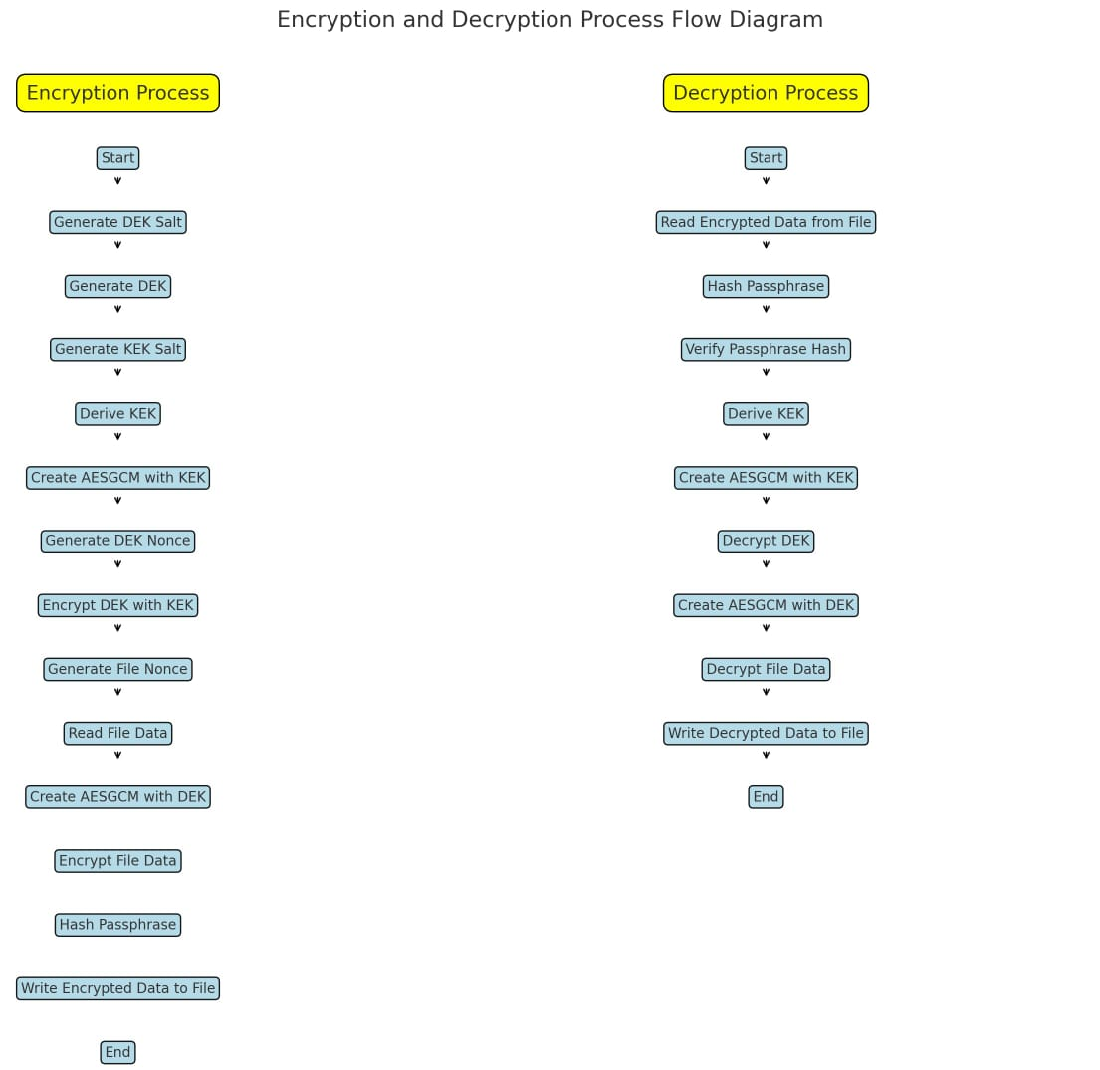
Process flow

Slide 6
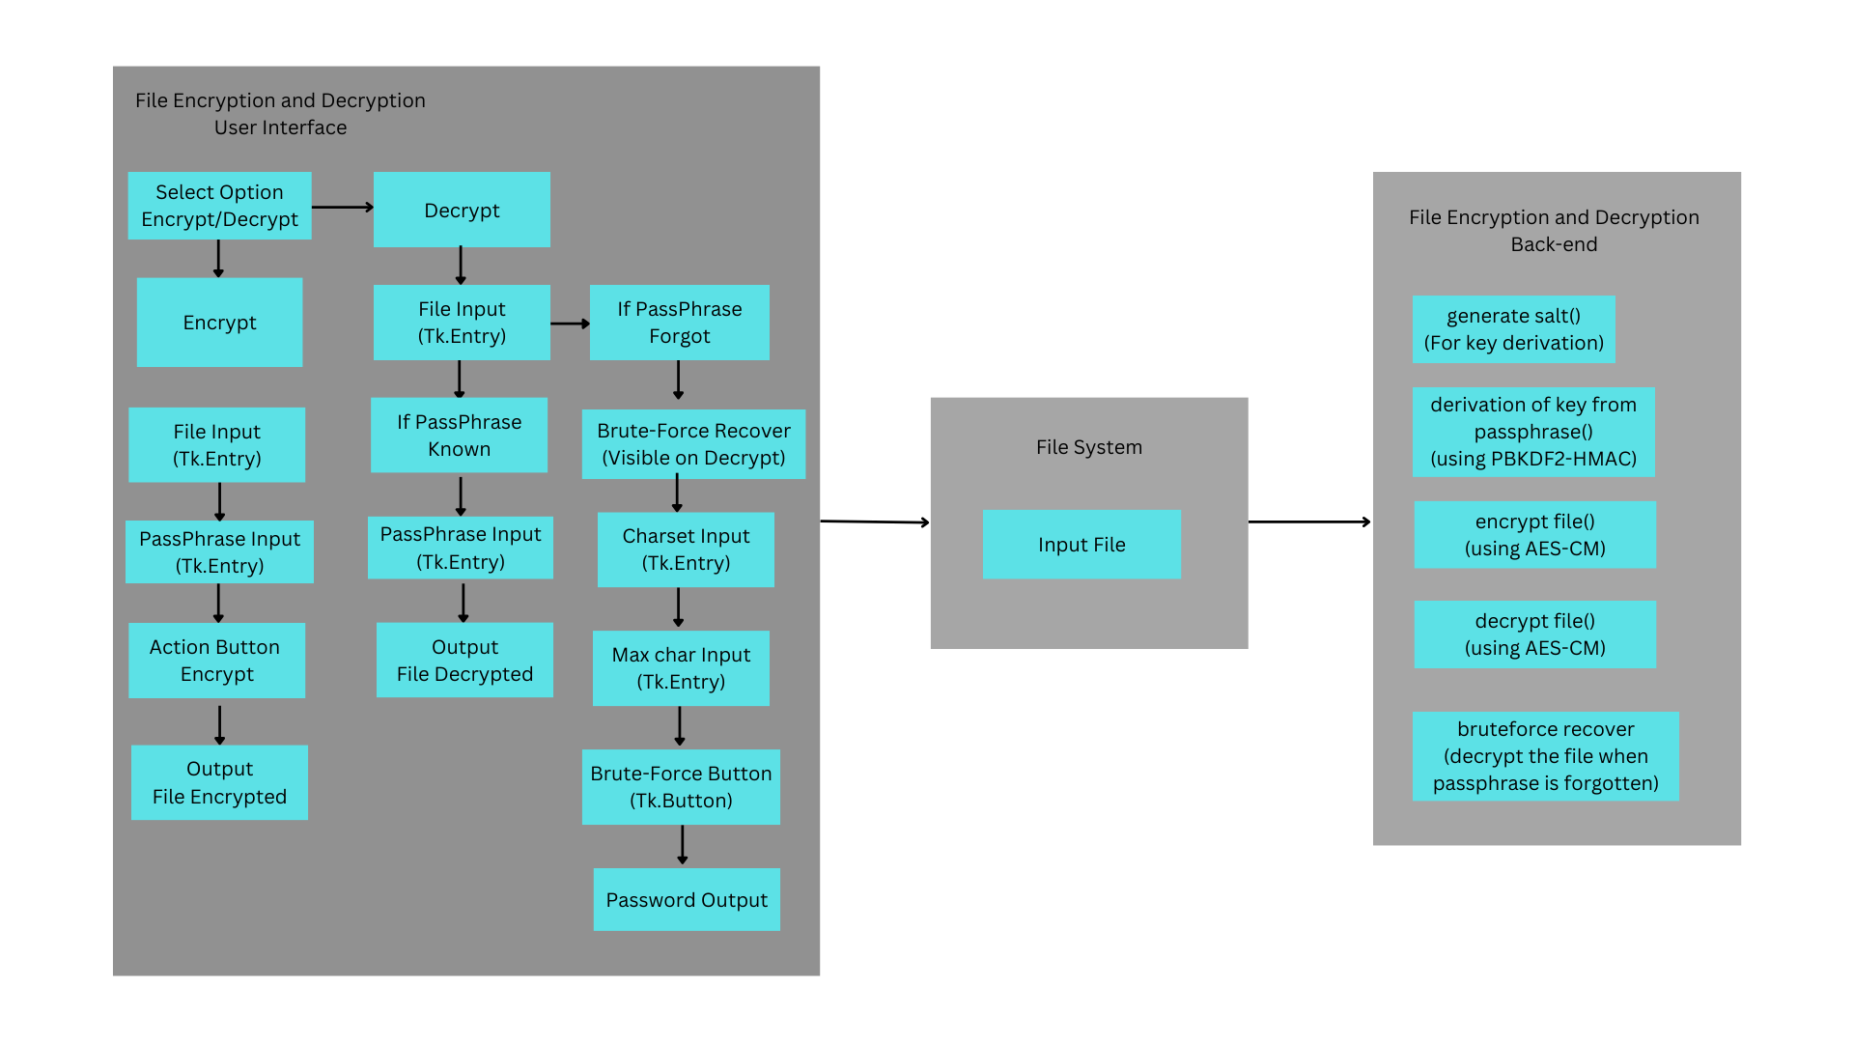
Architecture Diagram

Slide 7
Technologies used
Operating System:
Kali-Linux
Programming Language:
Python
Python Libraries (Cryptography, Tkinter, Itertools)

Slide 8
Team members and contribution:
Shashank Manognya (Back-end Development).
P V S S Mohith (GUI Development)
K Poorna Chandra Vihari (Testing, Modification)
Kavali Sreekanth (Back-end Development)
Jamdar Tahirullah(Gui Development)
Sylaja Vallee Narayan Sreenivasan Retnabai (Mentor)

Slide 9
Conclusion
Our File Encryption/Decryption Application provides a robust and user-friendly solution for securing sensitive data. The additional brute-force recovery feature ensures data can be retrieved even if the passphrase is lost. This application leverages strong encryption techniques and a simple interface to make data security accessible to everyone.

